Slide 1
Lead scoring case study
Manish Kumar
Mohammad Hussain
Chhavi Mehndiratta ​

Slide 2
AGENDA
Problem Statement
Methodology
Data Manipulation
​Exploratory Data Analysis
Model Building

Slide 3
PROBLEM STATEMENT
X Education sells online courses to industry professionals.
X Education gets a lot of leads, its lead conversion rate is very poor. For example, if, say, they acquire 100 leads in a day, only about 30 of them are converted.
To make this process more efficient, the company wishes to identify the most potential leads, also known as ‘Hot Leads’.
If they successfully identify this set of leads, the lead conversion rate should go up as the sales team will now be focusing more on communicating with the potential leads rather than making calls to everyone
Business Objective
X education wants to know most promising leads.
Building a suitable model which identifies the hot leads.

Slide 4
Methodology
Data cleaning and data manipulation.
Check and handle duplicate data.
Check and handle NA values and missing values.
Drop columns, if it contains large amount of missing values and not useful for the analysis.
Imputation of the values, if necessary.
Check and handle outliers in data.
Exploratory data Analysis
Univariate data analysis: value count, distribution of variable etc.
Bivariate data analysis: correlation coefficients and pattern between the variables etc.
Feature Scaling & Dummy Variables and encoding of the data.
Classification technique: logistic regression used for the model making and prediction.
Validation of the model.

Slide 5
Data cleaning and Manipulation
All the values were converted into lower base for consistency
Some binary variables (Yes/No) were converted into numeri variables 0/1
Columns which had only one unique value were dropped off
Columns having minimum 35% Null values were dropped off
For, the columns with less than 35% Null values, NaN was converted into ‘Select’ and ‘not provided’ option as NaN means that no option was selected.

Slide 6
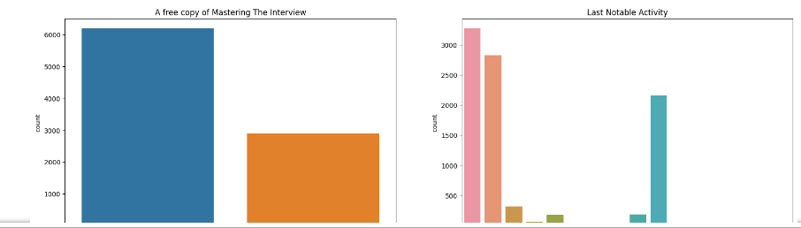
Performing EDA (1/2)
Univariate Analysis
In Univariate analysis, mainly count plots and histograms were plotted to ge the understanding of the counts and frequencies of the different variables present in the data

Slide 7
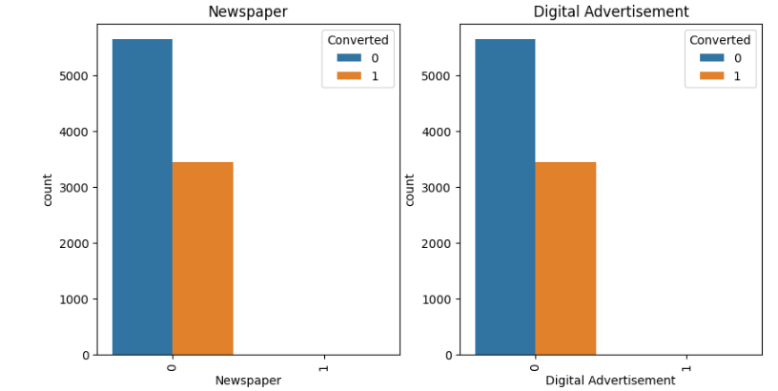
Performing EDA (2/2)
Bivariate Analysis
In Bivariate analysis, count plots were plotted keeping ‘Converted’ as the target variable and other independent variables

Slide 8
Data conversion
Before initiating the model building, the dummy variables were created using ‘get dummies’
The data type of Boolean columns was also converted into integer type

Slide 9
MODEL BUILDING (1/3)
Splitting the Data into Training and Testing Sets
The first basic step for regression is performing a train-test split, we have chosen 70:30 ratio.
Feature scaling
Checking correlation of variables using heat maps
Use RFE for Feature Selection
Running RFE with 15 variables as output
Building Model by removing the variable whose p- value is greater than 0.05 and VIF
value is greater than 5
Predicting the probabilities on train set and evaluating the model using accuracy, sensitivity specificity
Predictions on test data

Slide 10
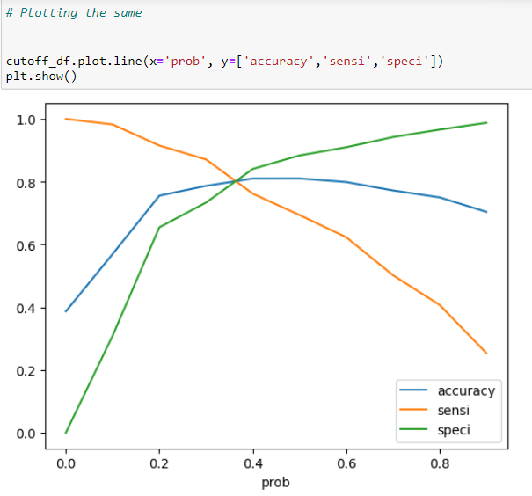
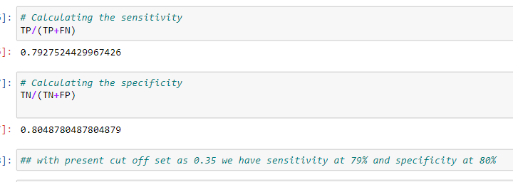
MODEL BUILDING (2/3)

Slide 11
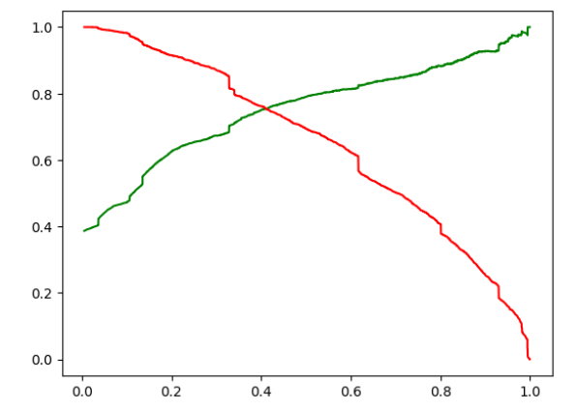
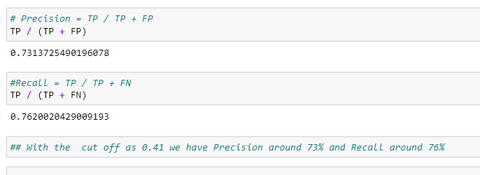
MODEL BUILDING (3/3)

Slide 12
Key insights
The variables identified as most influential in predicting potential buyers, ranked in descending order of importance, are:
Total time spent on the website.
Total number of visits.
Lead source, with emphasis on Google, Direct traffic, Organic search, and Welingak website.
Last activity, particularly SMS and Olark chat conversation.
Lead origin as Lead add format.
Current occupation as a working professional.
In conclusion, focusing efforts on these key variables presents an opportunity for X Education to significantly enhance its conversion rates by effectively engaging and persuading potential buyers.

Slide 13
THANK YOU
Mirjam Nilsson​
mirjam@contoso.com
www.contoso.com

